Slide 1

PRESENTED BY
JASWANTH GODAVARTHI
HARIISH G
VAKADA ROHIT
THARUUN M
ARUNKUMAR J
PSAT
PROJECT

Slide 2

A - STAR EXPLORER
Design a robotic brain that tells a given robot how to avoid obstacles while navigating from a fixed starting position to a fixed destination position in a matrix-based room.

Slide 3
STRATEGIES USED TO SOLVE A PROBLEM
Problem definition
Logical Thinking
1
It is a method to visualize the problem. This is done by presenting it from different angles and define the broader context and related problems.
2
It is the process of using rational and systematic series of steps to come to a conclusion for a given statement.
Algorithmic Thinking
Decomposition
3
Creating a set of sequential steps and then solving a problem to accomplish a task in a way that could be repeated by others.
4
It involves breaking down a complex problem into sub-problems that are easier to understand and solve them individually.

Slide 4
STRATEGIES USED TO SOLVE A PROBLEM
Pattern Recognition
Abstraction
5
It involves finding the similarities or patterns among small, decomposed problems that can help us solve more complex problems more efficiently
6
It is the process of ignoring out the characteristics of patterns that we don't need in order to concentrate on those that we do. It is also the filtering out of specific details.
Modeling
Evaluation
7
Use of a physical or logical representation of a given problem to generate data and helps to determine decisions or make predictions about the problem
8
It is the process that allows us to make sure our solution does the job it has been designed to do and to think about how it could be improved.

Slide 5
PROBLEM DEFINITION
USING A MODIFIED AI (ROBOTIC BRAIN) THAT CAN ASSIST THE ROBOT FROM A FIXED INITIAL POSITION 0,0 IN A NXN MATRIX TO THE FINAL DESTINATION DESIGNATED BY THE USER BY REDIRECTING THE GIVEN STARIGHT PATH TO ANOTHER ALTERNATIVE PATH IF THERE ARE ANY OBSTACLES PRESENT IN THE WAY
PARAMETERS
REQUIREMENTS
ASSUMPTIONS
NxN Matrix with K Obstacles are the parameters
A Functional Robot with Fixed Initial and Destination point
We would be assuming the case of a 4x4 matrix
AIM
Our Main Objective is to develop a new algorithm for solving the problem of robot path planning with static obstacles avoidances. This planning, also called static path plan, presents the advantage of ensuring safety and shortness of the path. Moreover, the proposed algorithm is characterized by a reactive behavior to find a collision-free trajectory and smooth path.

Slide 6

LOGICAL THINKING
BOOLEAN LOGIC
We use Boolean logic to configure functions to do identify different path ways and analyse which path ways should be choose to reach the destination without any hassles
1
LOGICAL OPERATORS
We use logical operators to operate different functions according to the given condition and different scenarios to dictate the proper flow of the function we use this most importantly in getting a proper Boolean logic according to the logic
2
We use Boolean and logical operators to work efficiently

Slide 7
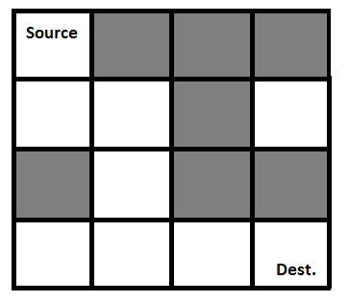
APPROACH
Form a recursive function, which will follow a path and check if the path reaches the destination or not. If the path does not reach the destination then backtrack and try other paths.
MODEL
Grey blocks are dead ends
White blocks are pathways
{1, 0, 0, 0} {1, 1, 0, 1} {0, 1, 0, 0} {1, 1, 1, 1}
{1, 0, 0, 0} {1, 1, 0, 0} {0, 1, 0, 0} {0, 1, 1, 1}
Matrix Representation
Output Representation

Slide 8
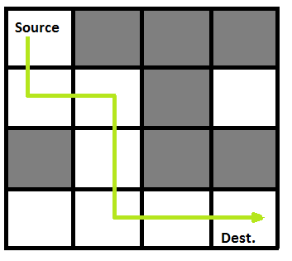
ALGORITHM
Create a solution matrix, initially filled with 0’s.
Create a recursive function, which takes initial matrix, output matrix and position of robot (i, j).
if the position is out of the matrix or the position is not valid then return.
Mark the position output[i][j] as 1 and check if the current position is
destination or not. If it reaches the destination print the output matrix.
5. Recursively call for position (i+1, j) and (i, j+1). Until it reaches the destination
6. Unmark position (i, j), i.e output[i][j] = 0.

Slide 9
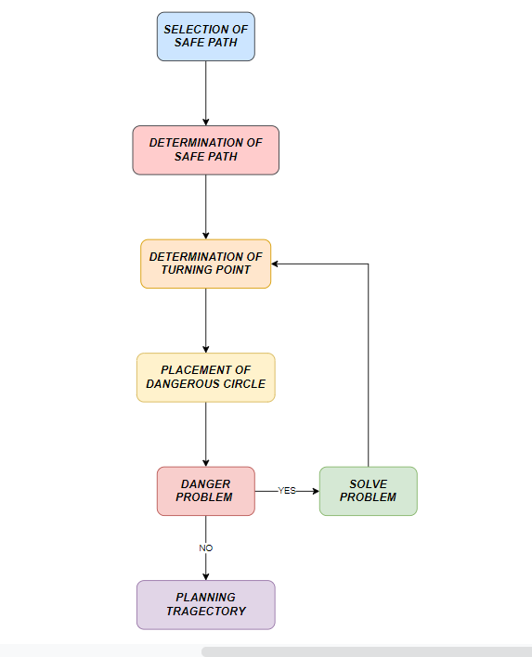
DECOMPOSITION
The proposed solution can be decomposed so that it would be more flexible to understand and solve
SELECTION OF SAFE PATH
The safe path aims to find a free path that helps the robot to reach the target without hitting obstacles of the environment
DETERMINATION OF SHORTEST PATH
When the robot goes to reach the target position, it is important to do it in the shortest path as possible.
Demonstrate
PROBLEM EXAMINATION
Even when the adequate path is determined, some problems can persist whose results makes the obstacle unavoidable.

Slide 10

PATTERN RECOGNITION
Pattern recognition is looking for similarities within decomposed problems
Patterns found in our programs include
Patterns observed are for ‘True’ or ‘False’.
True is when there is no obstacle and false is when there is an obstacle
For the case being ‘True’ the robot proceeds further
For the case being ‘False’ the robot takes another path
At every point it looks for all possible ways

Slide 11

ABSTRACTION
Here the primary objective of the solution is based on turning point strategy for solving the problem of robot path planning .
The aim of the turning point approach is to search a safe path for the mobile robot, to make the robot moving from a starting position to a destination position without hitting obstacles.
The path planning problem is one of the most researched topics in autonomous robotics. That is why finding a safe path in a cluttered environment for a mobile robot is an important requirement
A developed algorithm based on free segments and a turning point strategy for solving the problem of robot path planning in a static environment is presented.
This proposed algorithm handles two different objectives which are the path safety and the path length.

Slide 12
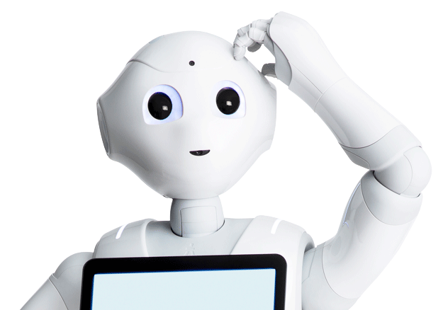
ALTERNATIVE SOLUTION
APPROACH : Find the source index of the cell in each matrix and then recursively find a path from source index to destination in the matrix. The algorithm involves recursively finding all the paths until a final path is found to the destination.
ALGORITHM
return True.
4.Call the recursion function for all adjacent empty and unvisited cells.
5.If any of the recursive functions returns true then unmark the cell and return true else unmark the cell and return False.
Find the starting index of the matrix.
Create a recursive function that takes the index and visited matrix.
Mark the current cell and check if the current cell is a destination or not. If the current cell is destination

Slide 13
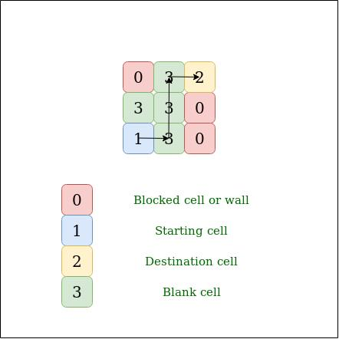
EXAMPLE

Slide 14
MODEL
Given N X N matrix filled with 1, 0, 2, 3. Find whether there is a path possible from source to destination, traversing through blank cells only. You can traverse up, down, right, and left.
A value of cell 1 means Source.
A value of cell 2 means Destination.
A value of cell 3 means Blank cell.
A value of cell 0 means Obstacle.
Note: There is only a single source and single destination.
Example
M[3][3]
{{ 0, 3, 1 }, { 3, 0, 3 }, { 2, 3, 0 }}; Output : Yes, it reached the destination

Slide 15

ANALYSIS OF ALTERNATIVE SOLUTION
The time complexity of the proposed solution is long as we are doing a lot of redundant work as there are similar type of ways getting computed repeatedly. So, as the recursion grows deeper in bigger matrices, more and more unnecessary repetition occurs.
The alternative solution can be concluded to have an easier algorithm than the proposed solution but when it comes to real life implementation the proposed one seems to be the better suitable one due to time complexity

Slide 16



BOUNDARY CASES:
When the obstacles are present in such a way that the diagonal is the only path to reach the destination.
When there is only a single path and it ends up covered by obstacles.
When the destination is covered completely by obstacles.
When either the start or the end point is not specified inside the room.
When the destination itself has an obstacle.
1.
2.
3.

Slide 17
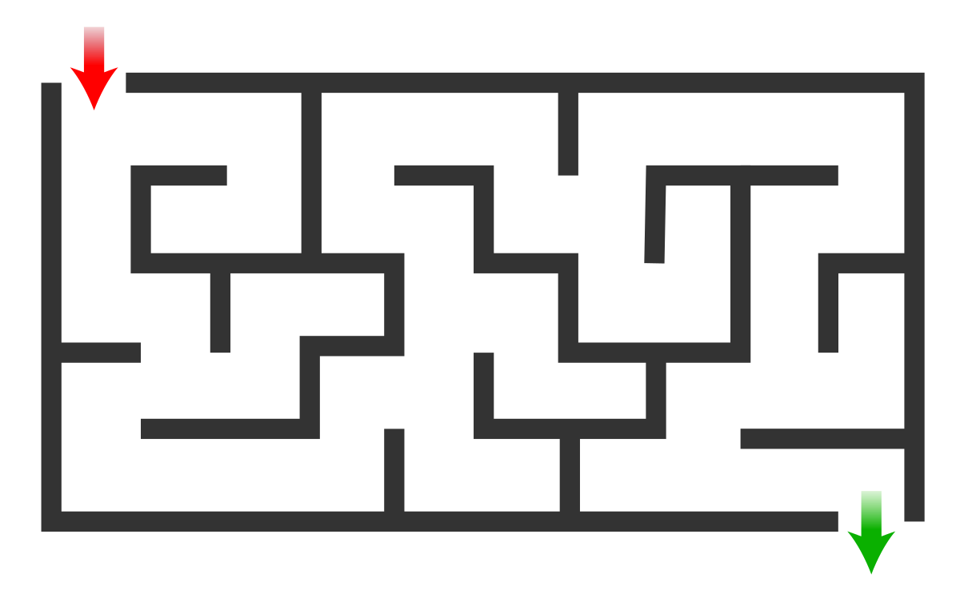
APPROPRIATENESS OF OUR SOLUTION IN NON TRIVIAL PROBLEMS:
Moving from one place to another. In case of a traffic, we may move in a different route.
Overcome the obstacles in a Snake game
Reaching a destination in a Maze.
INNOVATIVE PERSPECTIVES
A robot with high tension springs which allows them to jump when it faces an obstacle rather than finding an alternative path
A robot with fans and motors which help them fly rather than moving on the ground

Slide 18


